Slide 1

By Priya Dev (Evolution) team

Slide 2
Prerequisite
HTML5
CSS
Java Script (OOPs Concept)
MVC Architecture

Slide 3
Angular JS facts
Open-source JavaScript framework
Developed in 2009 by Miško Hevery and Adam Abrons
Maintained by Google

Slide 4
Why use it?
The problem – HTML is great for static pages, but has no tools for web applications
The solution – extend and adapt HTML vocabulary with some additional declarations that are useful for web applications
Notes:
Difference Between Window and Web Application
Introduction of Silver Light
MVC
MVC via Angular
JQuery vs AnuglarJs

Slide 5
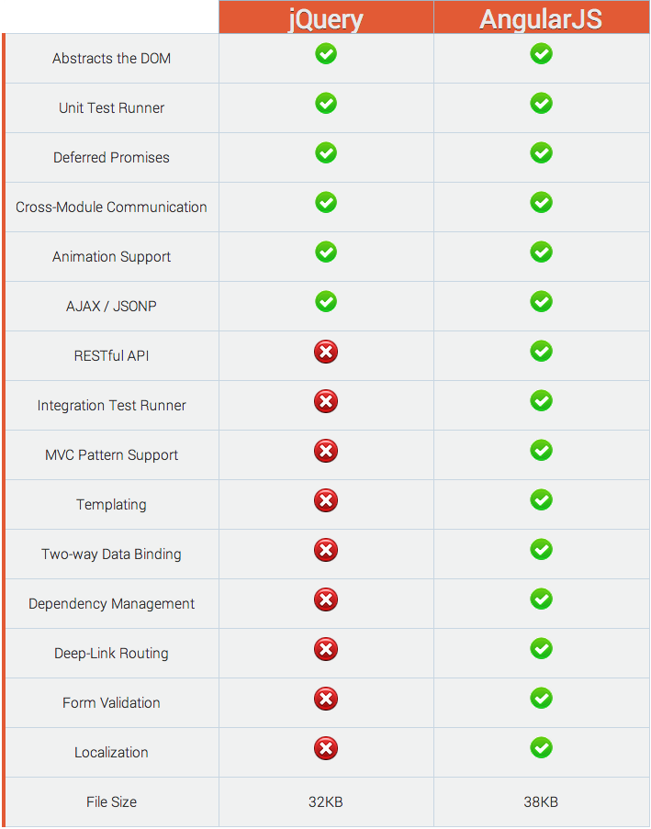
Jquery v/s AnuglarJS
Notes:
Test Runner: Jasmin Test
Templating: we can use it with all kind of language like PHP, Java and .Net
Dependency Management: RequiredJS

Slide 6
Example-1
Hello AngularJS

Slide 7
Questions?

Slide 8
Anatomy of an Angular application
Controllers
Models
Services
Directives
Modules
Filters
Factories
Scopes
Templates
Routes
Animations

Slide 9
What is Angular module?
Container for
Controllers
Services
Directives
Factories
Filters
Configuration information

Slide 10
Two-way data binding
View is updated automatically when the Model is changed
Model is updated automatically when a value in the View has changed
No DOM manipulation boilerplate needed!

Slide 11
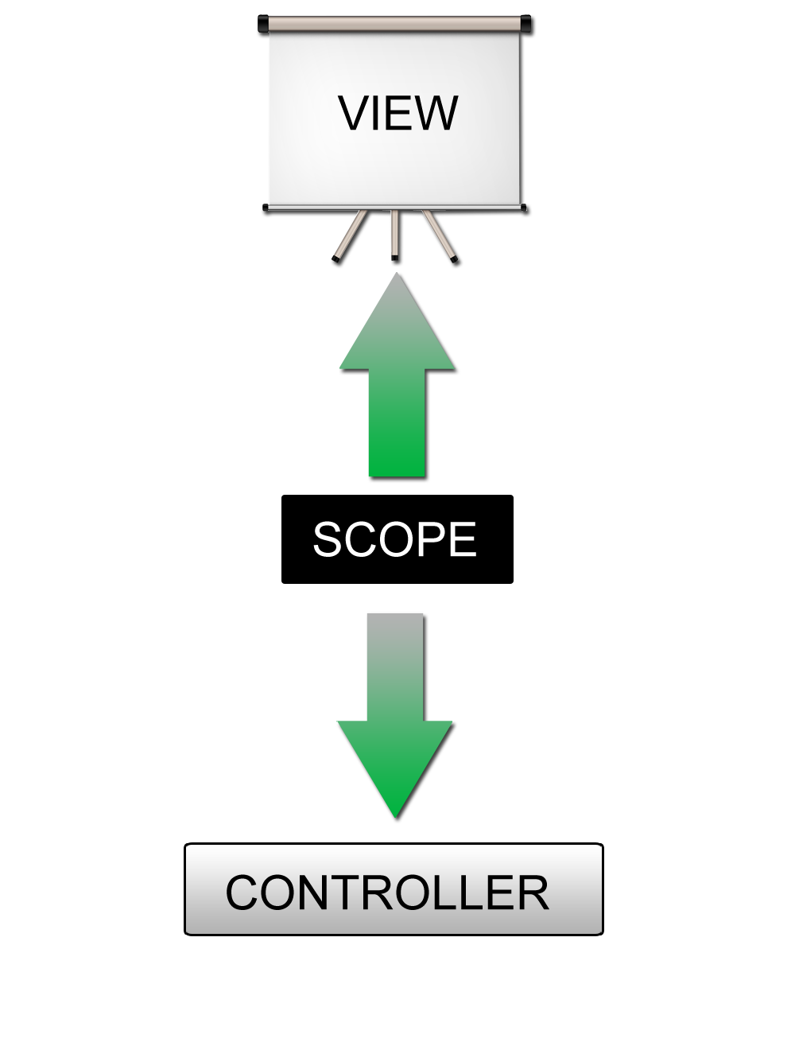
Two-way data binding illustrated

Slide 12
The Scope object ($scope)
One scope for each controller
The GLUE between the View and the Controller
A hash of key/values
Holds the data to display in the View
$rootScope object – visible in all controllers

Slide 13
Example-2
Hello Module & Contoller

Slide 14
Questions?

Slide 15
What is Angular directive?
Use them when you have to make DOM manipulations
Ever wanted to create your own tag or attribute – this is how you do it!
Takes you one step closer to creating domain-specific markup

Slide 16
Directive components in ng
ng-repeat
ngChecked
ngReadonly
ngSelected
ngValue
ngBind
ngChange
ngClass
ngClick
ngFocus
ngShow
ngHide

Slide 17
Form Validation
required
ngRequired
ngMinlength
ngMaxlength
ngPattern
ngChange
ngTrim

Slide 18
Example-3
Directives

Slide 19
Questions?

Slide 20
What is Angular filter?
Reusable operation using which you can modify the content that is shown on the page
Examples: uppercase a value, filter search results, etc

Slide 21
List of Filters
currency | Format a number to a currency format.
filter | Select a subset of items from an array.
lowercase | Format a string to lower case.
orderBy | Orders an array by an expression.
uppercase | Format a string to upper case.

Slide 22
Example-4
Filters

Slide 23
Questions?

Slide 24
Service components in
$http:
The $http service is a core Angular service that facilitates communication with the remote HTTP servers via the browser's XMLHttpRequest object or via JSONP
// Simple GET request example :
$http.get('/someUrl').
success(function(data, status, headers, config) {
// this callback will be called asynchronously
// when the response is available
}).
error(function(data, status, headers, config) {
// called asynchronously if an error occurs
// or server returns response with an error status.
});

Slide 25
Service components in ng
$location:
The $location service parses the URL in the browser address bar (based on the window.location) and makes the URL available to your application. Changes to the URL in the address bar are reflected into $location service and changes to $location are reflected into the browser address bar.
$log;
Simple service for logging. Default implementation safely writes the message into the browser's console (if present).
$q
A service that helps you run functions asynchronously, and use their return values (or exceptions) when they are done processing.
$rootScope
Every application has a single root scope. All other scopes are descendant scopes of the root scope. Scopes provide separation between the model and the view, via a mechanism for watching the model for changes. They also provide an event emission/broadcast and subscription facility. See the developer guide on scopes.
Notes:
$location: Return path

Slide 26
Example-5
Registration Form
Login Form
List

Slide 27
Angular JS best practice
Create a separate for module for
Services
Controllers
Filters
Parts are more isolated and decoupled
Easier to test a part of the application

Slide 28
Some great resources
http://www.egghead.io/ - Angular JS video course by John Lindquist (@johnlindquist)
http://www.yearofmoo.com/ - a blog that contains some great articles about Angular JS
http://angularjs.org/ - Angular JS official web-site
http://docs.angularjs.org/api/ - Angular JS API reference
https://groups.google.com/group/angular/ - Angular JS Google Group
https://chrome.google.com/webstore/detail/angularjs-batarang/ighdmehidhipcmcojjgiloacoafjmpfk?hl=en - Angular JS Batarang, a great solution for debugging Angular JS applications
https://www.youtube.com/watch?feature=player_embedded&v=q-7mhcHXSfM#! - A video demo of using Batarang

Slide 29
Some great resources
https://github.com/angular/angular-seed
A starting point for Angular JS projects
Includes end to end tests folder where you could easily add some tests to your app using Jasmine
http://docs.angularjs.org/guide/dev_guide.e2e-testing
A guide to testing Angular JS applications
https://developer.mozilla.org/en-US/docs/Web/JavaScript/Introduction_to_Object-Oriented_JavaScript
Java Script OOPs Concept

Slide 30
FAQ?
Why is this project called "AngularJS"? Why is the namespace called "ng"?
Because HTML has Angular brackets and "ng" sounds like "Angular".
How big is the angular.js file that I need to include?
The size of the file is ~50KB compressed and minified.
Does Angular use the jQuery library?
Yes, Angular can use jQuery if it's present in your app when the application is being bootstrapped. If jQuery is not present in your script path, Angular falls back to its own implementation of the subset of jQuery that we call jQLite.

Slide 31
Questions?

Slide 32
Thank you for your time

